Slide 1

T99X171.00 Bluetooth Crystal Is Not Oscillate Issue Report
Prepared by: PE- Nam
Date: January 27th 2022

Slide 2
Background Information
1. Background Information :
As ALT customer feedback, they found the field issue that Bluetooth function is repeatedly restarting.
And analyzed the root cause is crystal is not oscillate 20Mhz.
Unit information:
- MAC : B4B5B6FED142
- S/N : 2149688001202108062083
- MO: 2639001189
No.# | Name | Main source | Location | Describe Material | Vendor source
1 | Crystal | 308.03263.075 | Y1001 | CN-GP XTAL 20MHz 20ppm 8pF 50ohm SMD GP/HF | HOSONIC

Slide 3




Log Test Checking
1. Check log test of NG product
- Check log test NG product at all stations.
No # | Station | Log Test | Result
1 | UK |  | Pass
2 | FT |  | Pass
3 | FT1 |  | Pass
4 | RC |  | Pass
5 | RC1 |  | Pass
Summary:
- NG board test R_ at FT station 1 time: with “boot up fail” error code, change new U1 → NG board Pass normal.

Slide 4
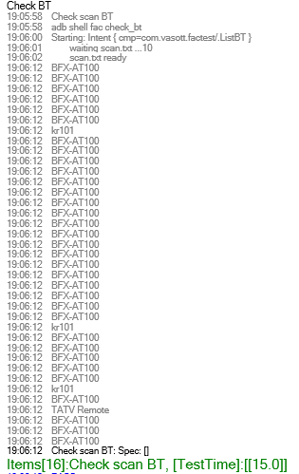
Bluetooth Function Test at FT1 Station
1. Check Bluetooth function of product at FT1 station:
Summary:
- Product test Bluetooth function at FT1 station Pass normal.

Slide 5
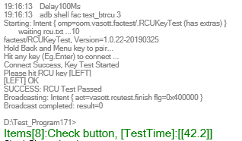
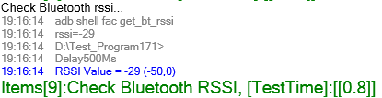
Bluetooth Function Test at RC Station
1. Check Bluetooth function of product at RC station:
Summary:
- Product test Bluetooth function at RC station Pass normal.

Slide 6
Test Condition
Test Condition:
Temperature: 24.3⁰C
Humidity: 43.3%
Summary:
- Environment condition normal.

